Slide 1

Online Pharmacy Shopping Web Application
By Agni Squad
GitHub Link:
https://github.com/thisisgovind/GetPharm.info
Notes:
Image source: Google
http://www.genusit.com

Slide 2

Contents
Team Members
UTKARSH KUMAR
Introduction
Definition
Components of e-pharmacy
Pharmacy retails store
Features of GetPharm
Works of GetPharm
Web Looks
Future updations
(Team Leader)
ADITYA RAI
GOVIND KUMAR
AMRESH KUMAR

Slide 3
Introduction
Now-a-days we witness a phase transition of buying pattern of any goods, clothes, electronics, furniture, grocery, etc. With the advent of technology, offline shopping switches to online mode. Buying anything online is in fashion.
Online Pharmacy is going to be the next big evolution that will impact billions of lives and bring a healthy behavioural change to safer and more convenient tomorrow.
While many aspects of healthcare service delivery, like finding doctors or hospitals, booking appointments, payment of fees, booking a lab test, viewing lab test reports, have gone online, pharmacy is one area which still lags behind
before
after

Slide 4
Definition
The application of internet to access drugs and diagnostics which begin early in advent of info age has matured into portals or virtual drugs stores popularly known as "Internet pharmacy" or "Online pharmacy" or "Web pharmacy" or "Cyber pharmacy".
e-Pharmacies are online platforms where consumers can purchase medicines without having to visit brick-and-mortar pharmacies. This makes the process more convenient for consumers and has resulted in a rising demand for the model across the world. In addition, increasing utilization of e- Prescriptions in the hospitals, globally, it has also led to the growth of this industry.

Slide 5
Components of e-pharmacy
Technology
Web-based and/or mobile-based application for consumers transmits their prescriptions and place requests for medicines.
Order that is received is verified and checked by a registered pharmacist.
The registered pharmacist forwards the verified prescriptions to the pharmacy store from where the medicines are dispensed by a licensed pharmacy.
The web or mobile-based platform to be governed under the IT Act 2000 and rules there under.

Slide 6
Pharmacy retail store
The registered pharmacist at the store verifies the prescriptions before dispensing.
The medicines are dispensed from a licensed premises to the patient or patient's relative (Patient's agent).
An Invoice with batch number of the medicines dispensed, expiry date, name and address of the pharmacy with signature of the registered pharmacist/(s) is issued online.

Slide 7

Search your Medicine
Search nearby Pharmacies
Check Availability of Medicines
If Medicines is not available then it’s provides you alternate medicines
Fill your order and Receive your order at doorstep in few minutes.
1 2 3 4 5 6 7 8 9 10
Notes:
Content source:
https://new.siemens.com

Slide 8
Review your order and Pay through Cash-on-Delivery or other Payments Methods
01
Log on GetPharm and Buy
03
HOW IT WORKS
Sign up and find your medicine
Add health products and medicines to Cart
02
04
1 2 8 4 5 6 7 8 9 10

Slide 9
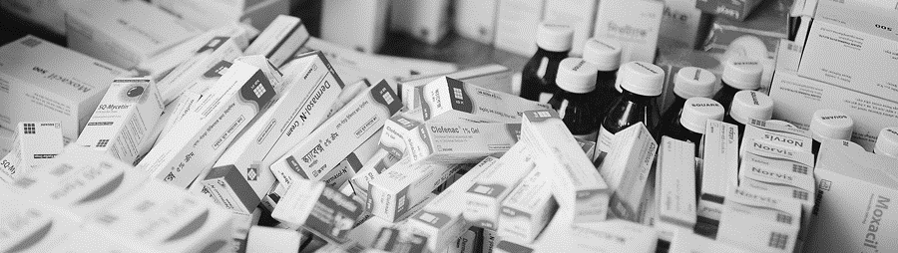
Future updates to enhance an GetPharm:
Telemedicine Integration:
AI-Powered Recommendations
As a Management
Incorporate telemedicine services allowing customers to consult with healthcare professionals online, making it a one-stop solution for both prescriptions and medical advice.
Implement artificial intelligence algorithms to provide personalized product recommendations based on customer's purchase history, browsing behavior, and health profile
We can upgrade as a doctor’s appointment booking, Hospital bed booking etc.
1 2 3 4 5 6 7 9 9 10
Notes:
Image source: Google
https://www.dhakatribune.com

Slide 10

“
THANK YOU
1 2 3 4 5 10 7 8 9 10
Notes:
Content source:
google

